Slide 1
L1. Introduction to CV
Oleksandr Baiev, PhD
Head of Machine Perception Lab
Samsung R&D Institute Ukraine

Slide 2
Course overview
L1. Introduction to Computer Vision
L2. Basics of Deep Learning for Computer Vision
P1. Tensorflow basics
L3. Instance Recognition
P2. Train Simple Model
P3. Model Improvement. Pre-trained models

Slide 3
What we are talking about?
Perceive
Decide
Do
Rely on different data
Visual
Time Series
Text
Images
Video
single camera
set of cameras
RGB, IR, ToF
other “2D” sensors

Slide 4
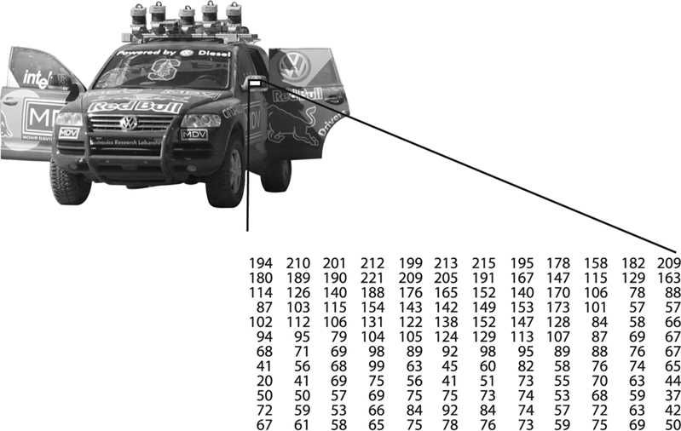
Image

Slide 5
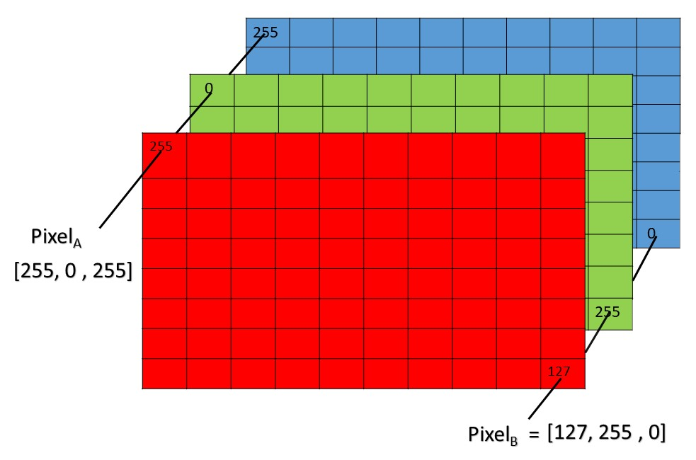
RGB Image

Slide 6

Classification
What is on image?

Slide 7
Localization and Detection
Where is object on image?

Slide 8
Instance Segmentation
Get exact object region?
May be considered as per pixel classification

Slide 9
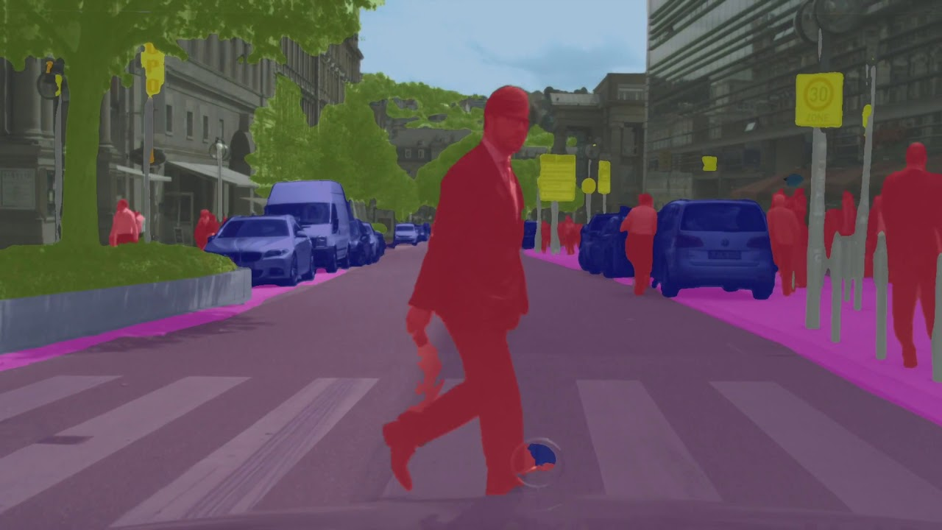
Semantic Segmentation
What kind of areas are on image?

Slide 10
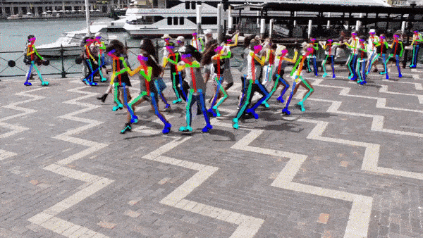
Keypoint Detection/Pose Estimation
What structure have object?
[1] Zhe Cao, Gines Hidalgo, Tomas Simon, Shih-En Wei, Yaser Sheikh OpenPose: Realtime Multi-person 2D Pose Estimation using Part Affinity Fields (2019)

Slide 11
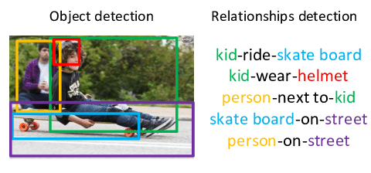
Object Relations Detection
What kind of relations are between objects?

Slide 12
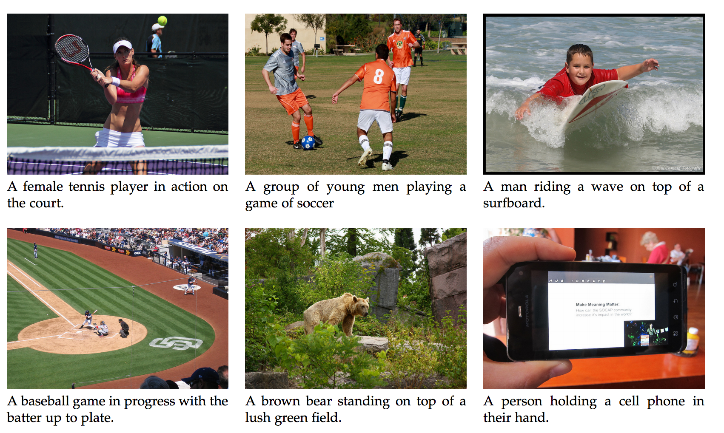
Image Captioning
What is happening on scene in the image?

Slide 13
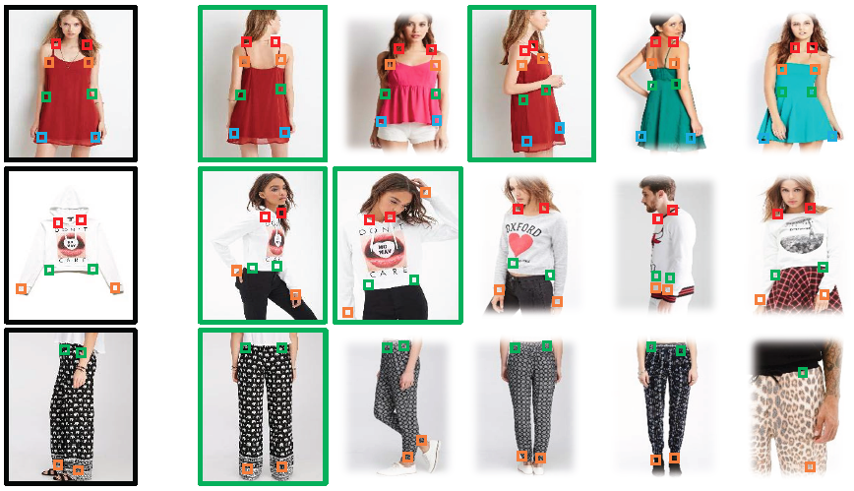
Image Retrieval
Which images similar to the current?

Slide 14
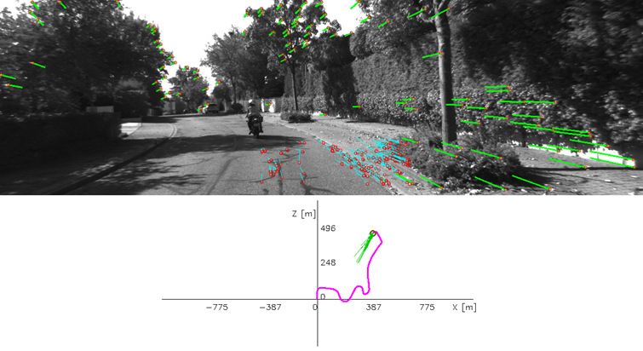
Visual Odometry
How camera moves in space?

Slide 15
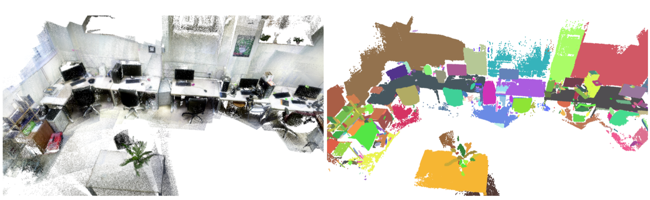
Environment Semantic Reconstruction
What is environment looks like?

Slide 16
Computer Vision and Machine Learning
Different cameras, light conditions, transformations, etc.

Slide 17
Golden Triangle
Features
Models
Represents image or part/parts of image
Solve particular problem (cls, obj det, keypoints, etc.)
Data
Define task

Slide 18
Human-crafted Features
Image
Human Crafted Features
ML methods
Result
Descriptors: SIFT, SURF, HOG, RMCT, etc.
AdaBoost, SVM, RF, part models, etc.
Highly depend on domain, rely on low-level knowledge and “manual” feature engineering

Slide 19
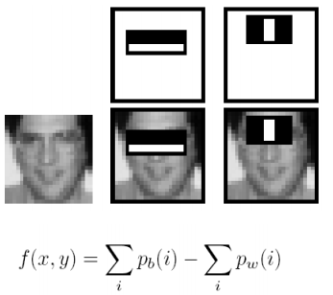
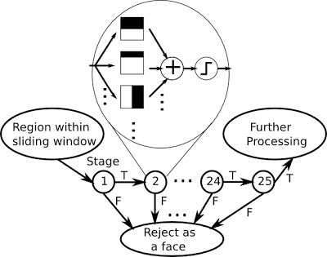
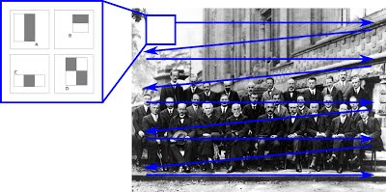
Features
[2] Paul Viola , Michael Jones Robust Real-time Object Detection (2001)

Slide 20
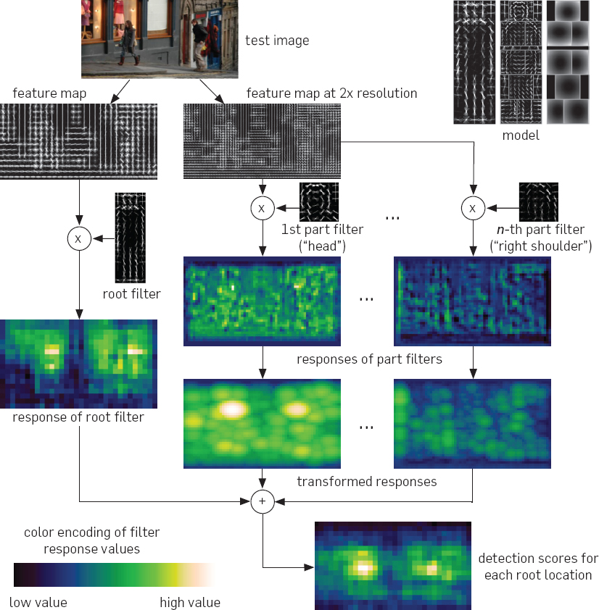
May be really hard
[3] Pedro F. Felzenszwalb, Ross B. Girshick, David McAllester Cascade object detection with deformable part models (2013)

Slide 21
Feature Engineering as Optimization Problem
Human Crafted Features
ML methods
Image
Result
Optimized Jointly
Features + Method trained end-to-end

Slide 22
Feature Engineering as Optimization Problem
Human Crafted Features
ML methods
Image
Result
Neural Networks
Features + Method trained end-to-end

Slide 23

Models Comparison

Slide 24
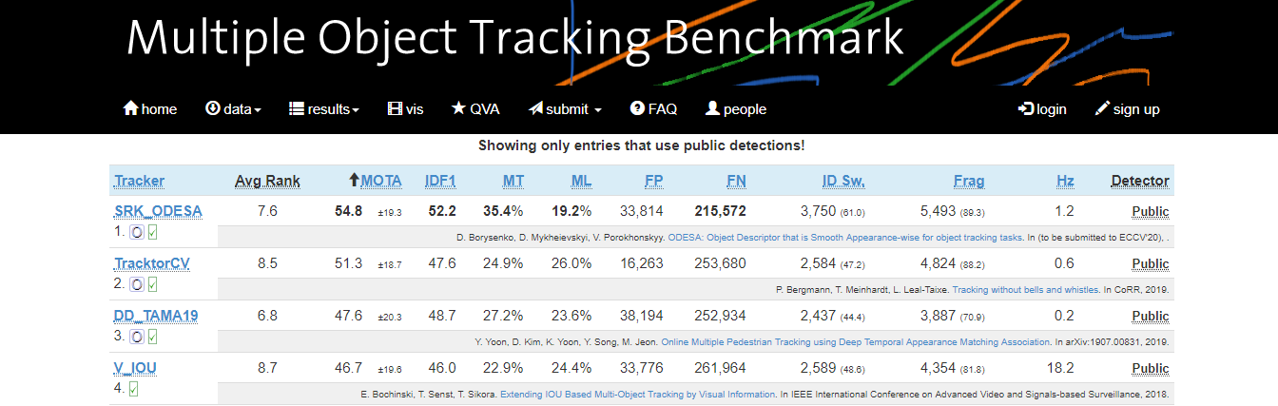
“Leaderboard”
Models may be compared by different metrics.
Mostly intuitive are accuracy and execution time.
https://motchallenge.net/results/CVPR_2019_Tracking_Challenge/

Slide 25
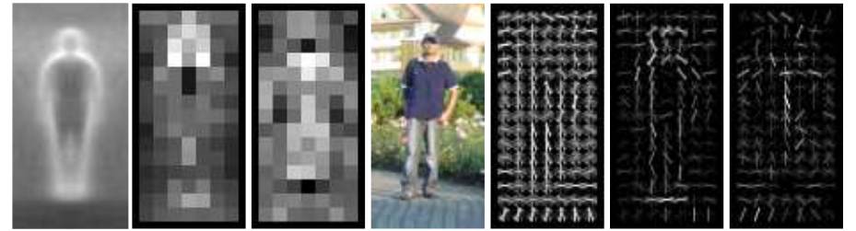
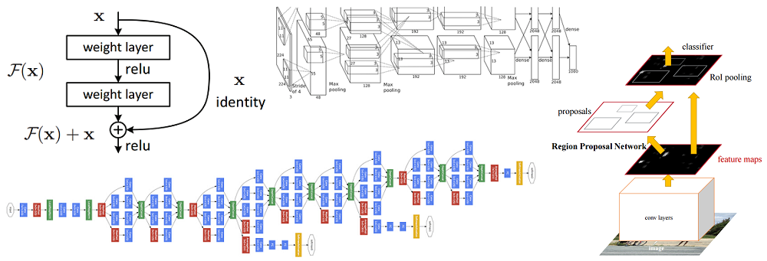
DL Hype
Era of Human-Crafter Features
Era of Deep Learning
Before
Raise and Mature
1986
BackProp
1998
LeNet
September 30, 2012
AlexNet [6]
[4] Rumelhart, David E., Hinton, Geoffrey E., Williams, Ronald J. Learning representations by back-propagating errors (1986)
[5] Y. LeCun, L. Bottou, Y. Bengio and P. Haffner Gradient-Based Learning Applied to Document Recognition (1998)
[6] Alex Krizhevsky, Ilya Sutskever, Geoffrey E. Hinton ImageNet Classification with Deep Convolutional Neural Networks (2012)

Slide 26
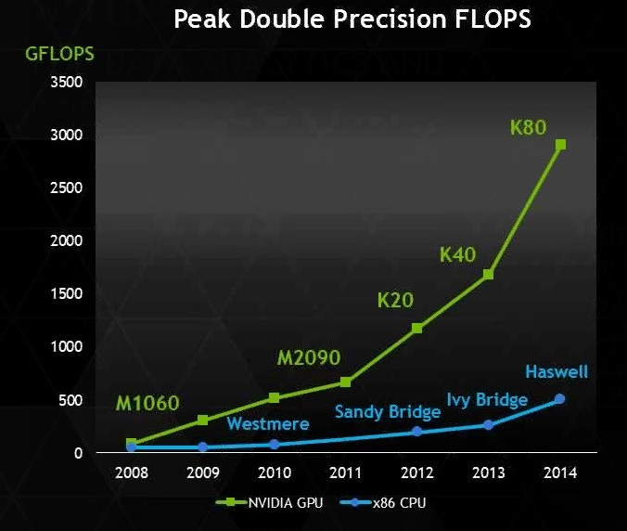
Behind the Scene. Processing Units
2012: AlexNet was trained on two NVIDIA GPUs for about a week
Important characteristics of GPU for DL:
Memory
Bandwidth
Performance

Slide 27
Are computational resources important?
No GPU -> No Party

Slide 28
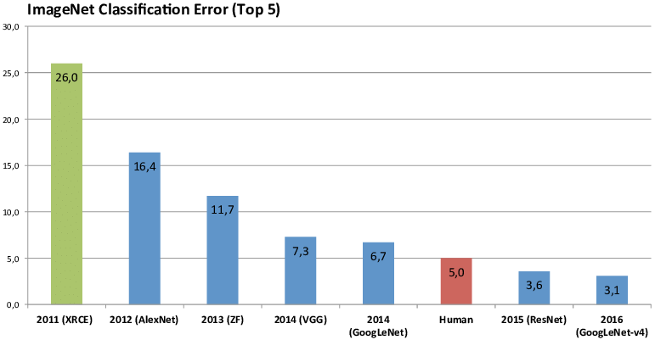
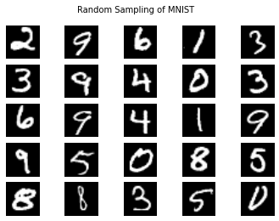
Behind the Scene
Before
Raise and Mature
MNIST
Cifar; ImageNet; COCO; Market 1501; OpenImages; KITTI/Cityscapes/Berkeley DeepDrive; And Many Other
ImageNet [7]
[7] Jia Deng, Wei Dong, Richard Socher, Li-Jia Li, Kai Li, Fei-Fei Li ImageNet A Large-Scale Hierarchical Image Database (2009)

Slide 29
Is data important?
No Data -> No Party

Slide 30
Dataset for CV
Images
Videos
Etc.
Data Annotations
or
“Ground Truth”
Today full annotations leads to the best performance.
Weak annotations and no annotations are topics for weakly- and un-supervised learning

Slide 31
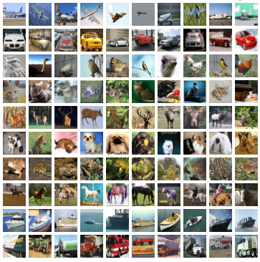
Public Datasets. CIFAR-10 - cls
Classes: 10
Problem: classification
Set:
training set of 50 000 examples
test set of 10 000 examples
ImageSize:
32x32x3
State of the art:
Class: Error 3.47%
[8] Alex Krizhevsky, Learning Multiple Layers of Features from Tiny Images (2009)
[9] https://www.cs.toronto.edu/~kriz/cifar.html

Slide 32
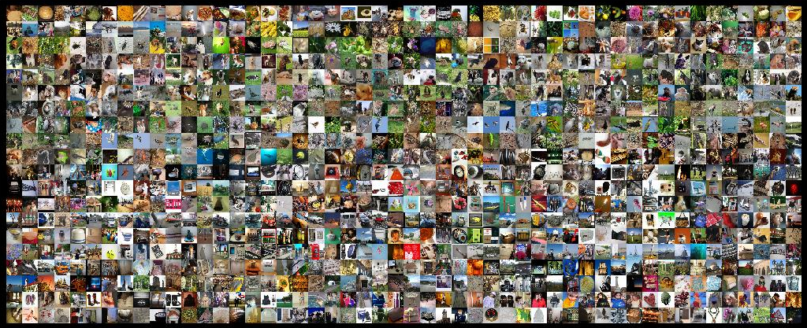
Public Datasets. ImageNet [ILSVRC] - cls
Classes: 1000, 200
Problem: classification, detection
Set:
1 200 000 examples
ImageSize:
variable
State of the art:
Class: Error 3.6%
Det: 0.62 mAP
[10] Jia Deng, Wei Dong, Richard Socher, Li-Jia Li, Kai Li, Fei-Fei Li ImageNet A Large-Scale Hierarchical Image Database (2009)
[11] http://www.image-net.org

Slide 33
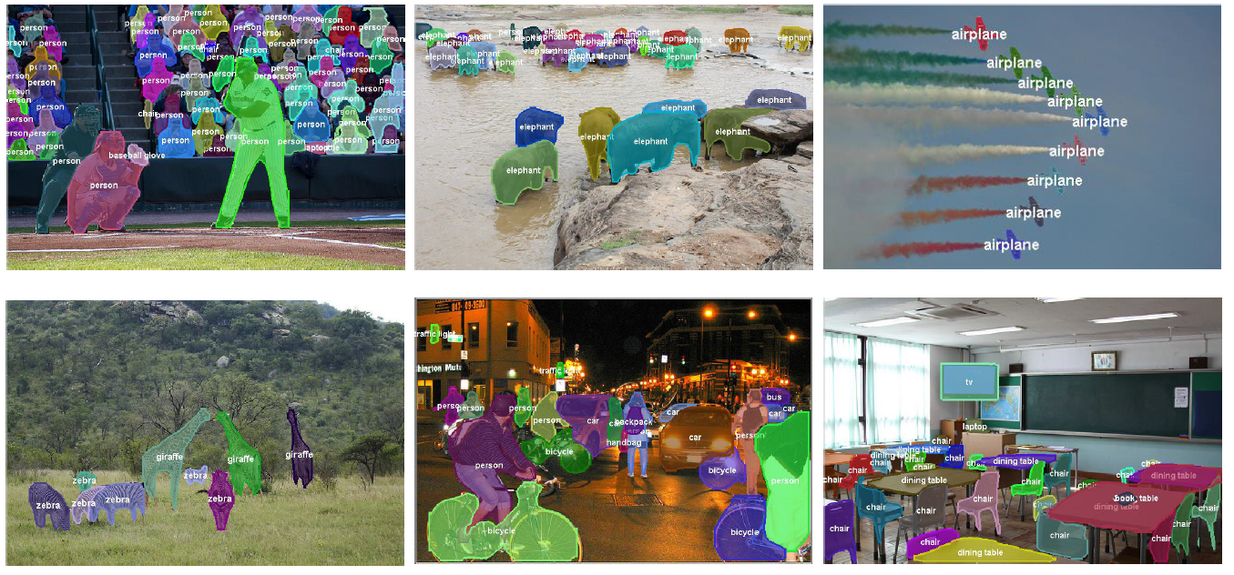
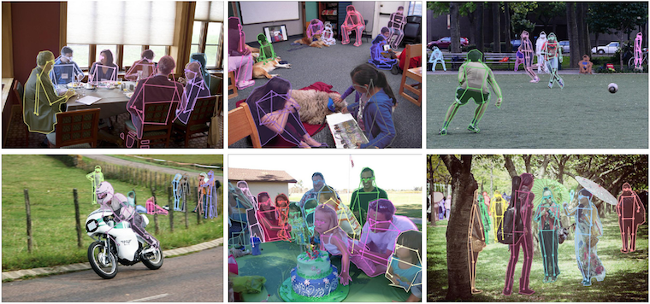
Public Datasets. COCO
Classes: 80
Problem: object detection, instance segmentation, panoptic segmentation, keypoint detection, captioning
Set:
training set of 115k examples
val set of 5k examples
test set of 40k examples
ImageSize:
~640x480x3
State of the art:
http://cocodataset.org
[12] Tsung-Yi Lin et al. Microsoft COCO: Common Objects in Context (2014)
[13] http://cocodataset.org

Slide 34
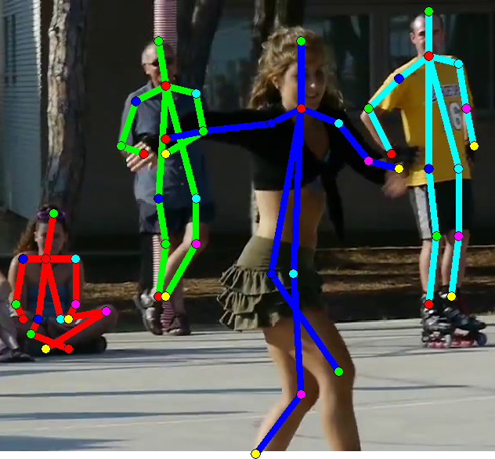
Public Datasets. MPII Human Pose Dataset
Joints: 14
Problem: skeleton, classification
Set:
25K images containing over 40K people
410 human activities
ImageSize:
variable
State of the art:
Skeleton: 86.3 mPCP
[14] Mykhaylo Andriluka and Leonid Pishchulin and Peter Gehler and Schiele, Bernt 2D Human Pose Estimation: New Benchmark and State of the Art Analysis (2014)
[15] http://human-pose.mpi-inf.mpg.de

Slide 35
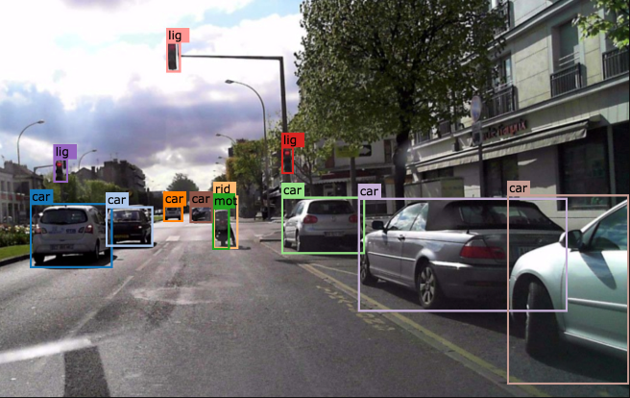
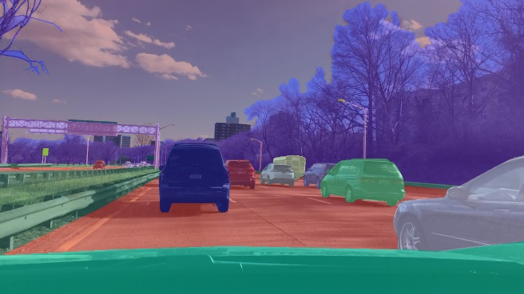
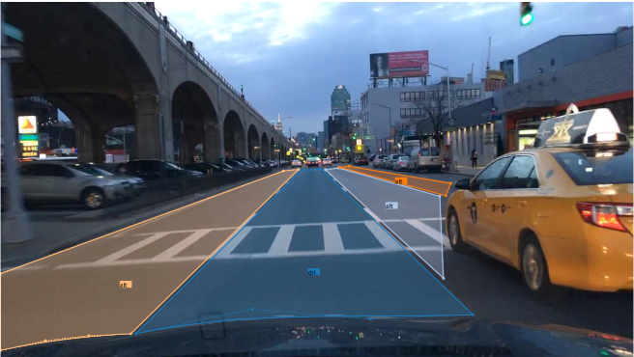
Berkeley Deep Drive
Problem: object detection (10 classes), instance segmentation, semantic segmentation, lane derection
Set:
set of 100,000 examples
ImageSize:
1280x720x3 ~ 2082x1312x3
State of the art:
https://bdd-data.berkeley.edu/wad-2018.html
[16] Fisher Yu, Wenqi Xian, Yingying Chen, Fangchen Liu, Mike Liao, Vashisht Madhavan, Trevor Darrell BDD100K: A Diverse Driving Video Database with Scalable Annotation Tooling (2018)
[17] https://bdd-data.berkeley.edu

